Slide 1

Man of Notes
Project Guide : Prof Vaidhehi V
Prof Ramamurthy

Slide 2

Man of Notes is a platform that focuses on providing notes to its users. This will allow users to browse documents and links that are available online and all are saved in one place.
The repository will develop over time and will get richer as users can upload their documents too. This allows the application to be unique and will help other users to get better fabricated notes.

Slide 3

The platform will have a forum where users can chat or discuss topics privately or publicly. That means if a user wants to ask specific question to another user, it can be facilitated easily or if his/her topics are open, they can directly share it publicly and other users can respond to it.
Features :
Subject wise note collection.
Sort notes in catergory
Plagiarism Review
Upload Notes
Chats
Quiz

Slide 4

How does it work?

Slide 5

AUTHENTICATION
DATABASE
STORAGE
HOSTING
ANALYTICS
Firebase

Slide 6

Natural Language
Analytics
Cost management
Api implementations
Google cloud

Slide 7


Concurrency

Slide 8

Existing Systems

Slide 9
Limitations
1. Contains ads
2. No sorting algorithm
3. One sided communication
4. No control on account
5. Not freely available
Edmodo

Slide 10

Limitations
1. No community content
2. Useful only after in-app purchase
3. Content only for enrolled students
4. High enrolment fees

Slide 11

Limitations
1. Spam notifications
2. Unoptimized application
3. Content only for schools
4. Too many bugs & glitches
5. No communication module
SChoology

Slide 12

Proposed System

Slide 13

Advantages
Community content
No in-app purchases
Free for all
Smart notes
Feedback
Offline & online availability

Slide 14

Hardware & Software Requirements

Slide 15
Android App
Component | Minimum Requirement | Maximum Requirement
RAM | 2GB | Or above
Processor | CPU Clock Speed: Up to 1.8 GHz | CPU Clock Speed: Up to 2.2 GHz
 | CPU Cores: Hexa-core CPU, 2x ARM Cortex A72, 4x ARM Cortex A53 | CPU Cores: Quad-core CPU, 4x Qualcomm® Kryo™ CPU
 | CPU Bit Architecture: 64-bit | CPU Bit Architecture: 64-bit
 | Existing processors with this or higher specifications:Snapdragon 650/ Helio P10/ Exynos 5433 | Existing processors with this or higher specifications:Snapdragon 800 or higher / Helio P20 or higher / Exynos 7420 or higher
Memory | Memory speed: 933MHz | Memory speed: 1866MHz
 | Memory Type: Dual-Channel, LPDDR3 | Memory Type: Dual-Channel, LPDDR4
Component Type | Requirement
System Version | Android Version 6.0 Marshmallow or above
Size | 20MB Approx
 | Free Space as download may require extra space depending upon the notes.
Cache Storage | 16mb Running Max.
Permissions | Storage permissions, notifications, google play, contacts & phone.

Slide 16

Functional Requirements

Slide 17

User
Register
Login
Search
Notes
Search & download
Upload
Chat
User select
Send message
Advertisement
Banner ad
Interstitial ad
Google API
Upload data
Fetch data
A. Modules

Slide 18

B. Interface requirements
Field amount only accepts numeric entries.
Text field accepts alpha-numeric entries.
Long press to select an object.
Single touch is accepted as open.

Slide 19

C. Security Requirement
Gmail user’s authentication only.
Database open for public.
Access to phone permission required.

Slide 20

C. Other Requirement
Data should be entered before request.
Cross checking required.
Accept the request and process.
Display any possible errors to the user.

Slide 21
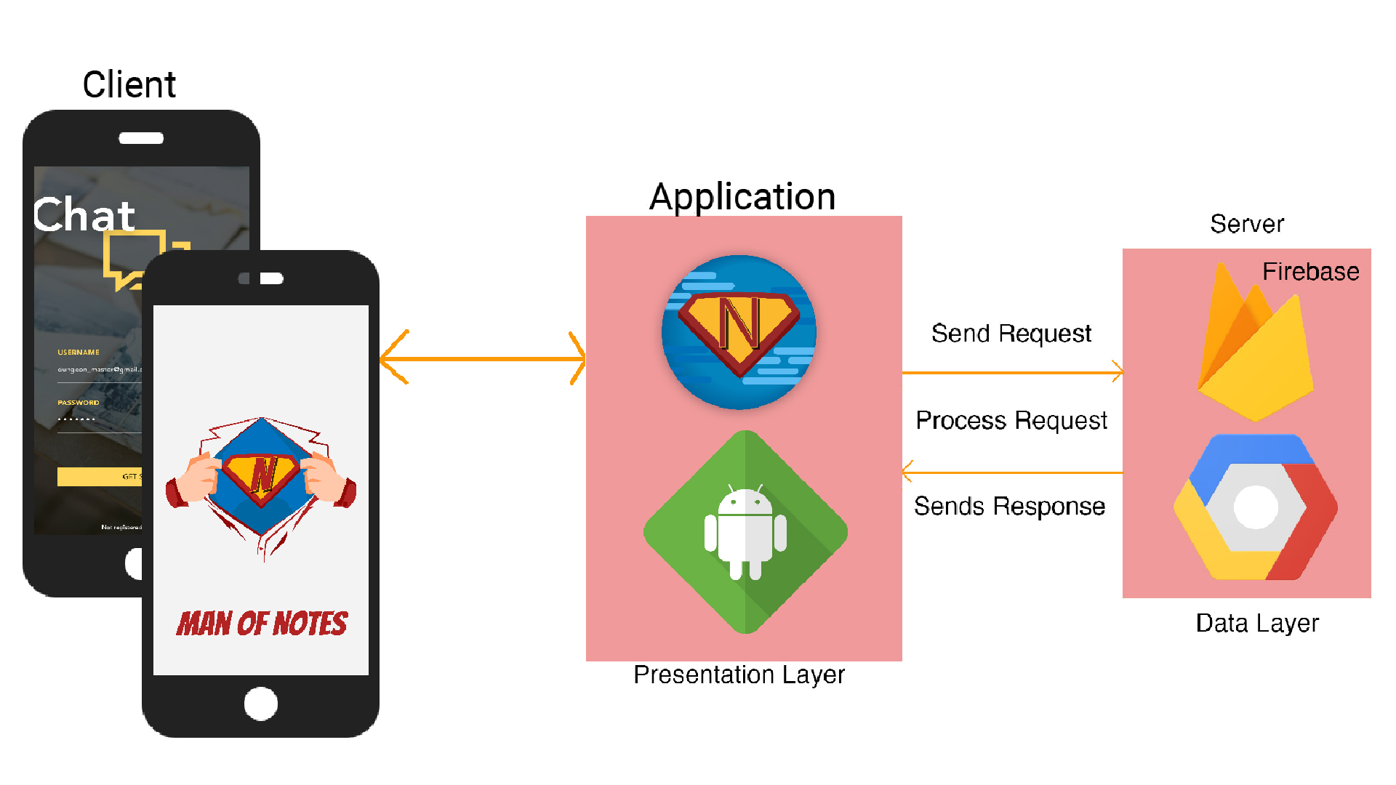
Application Architecture

Slide 22
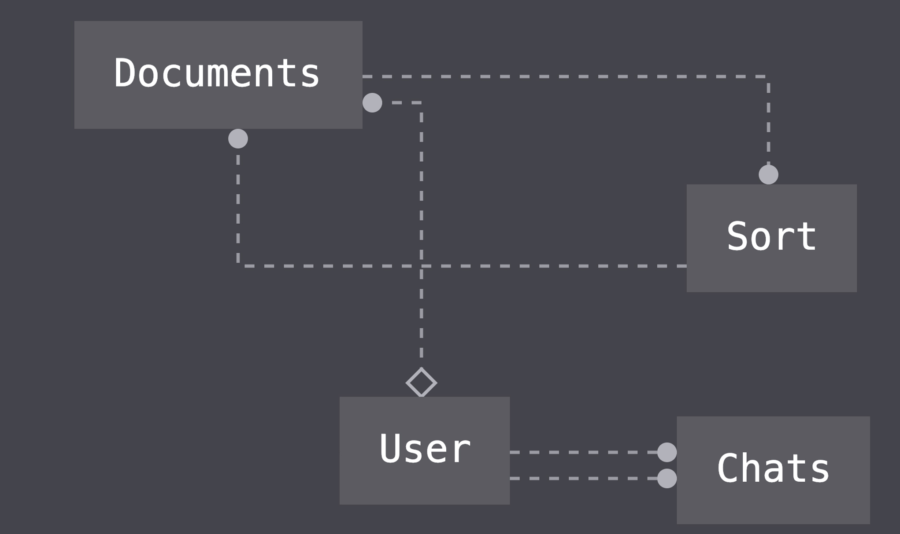
Database design
Data is efficient when normalised

Slide 23
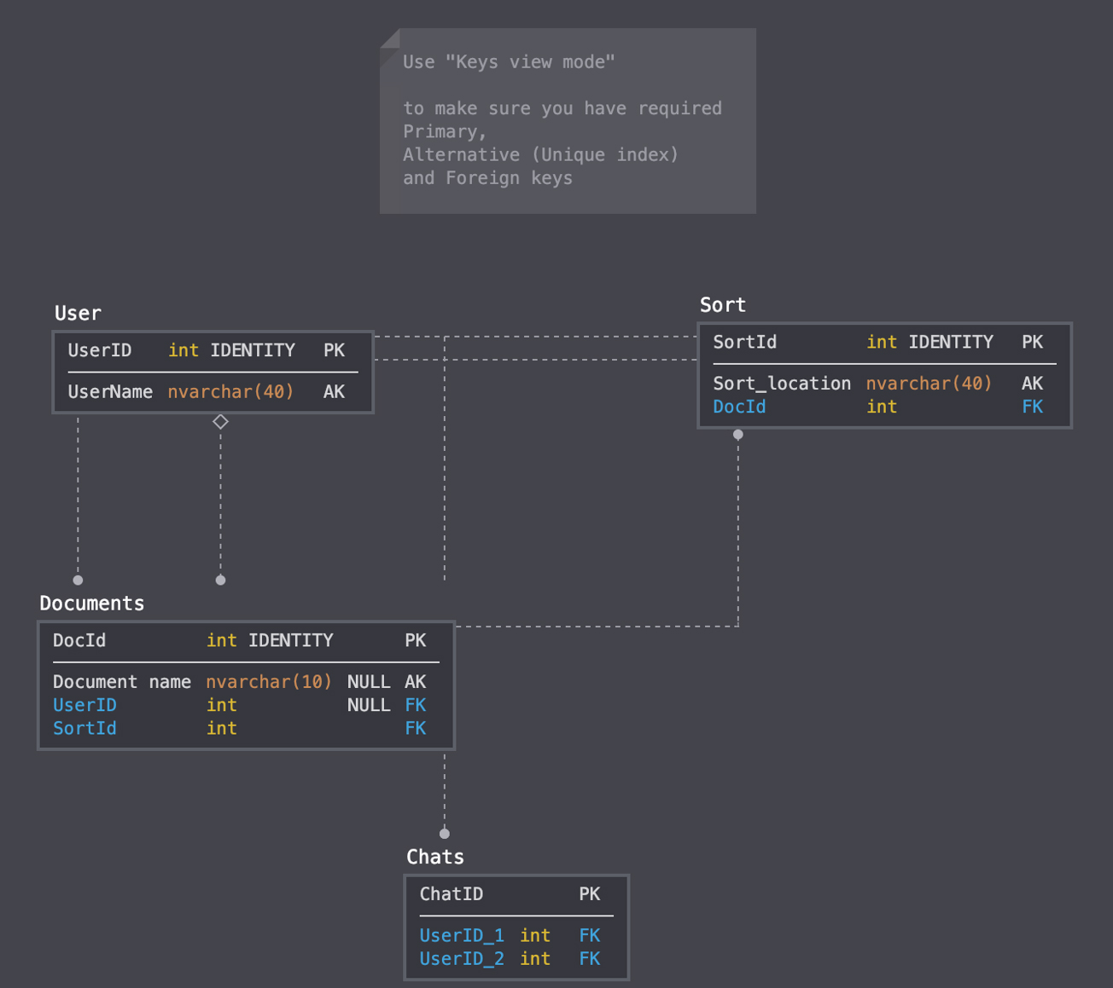
Database design
Data is efficient when normalised

Slide 24
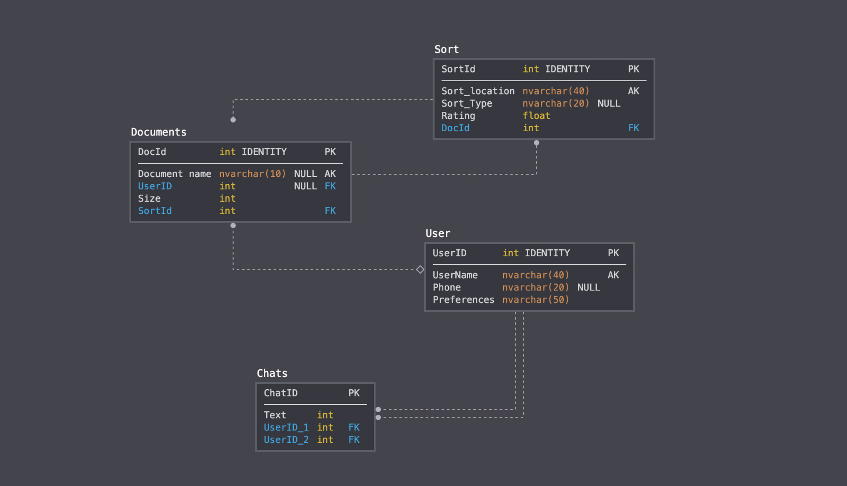
Database design
Data is efficient when normalised

Slide 25

Dataflow Diagram
LEVEL - 0
LEVEL - 1
LEVEL - 2
Notes:
\

Slide 26
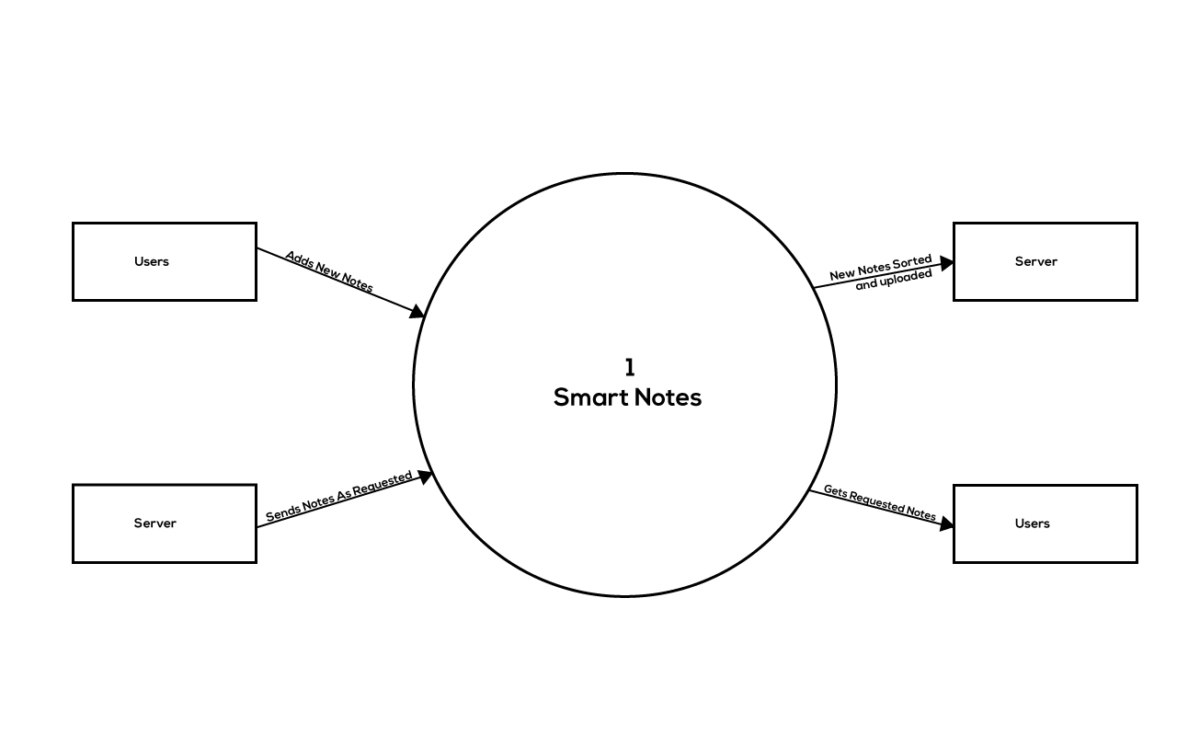
Level 0
Data is efficient when normalised

Slide 27
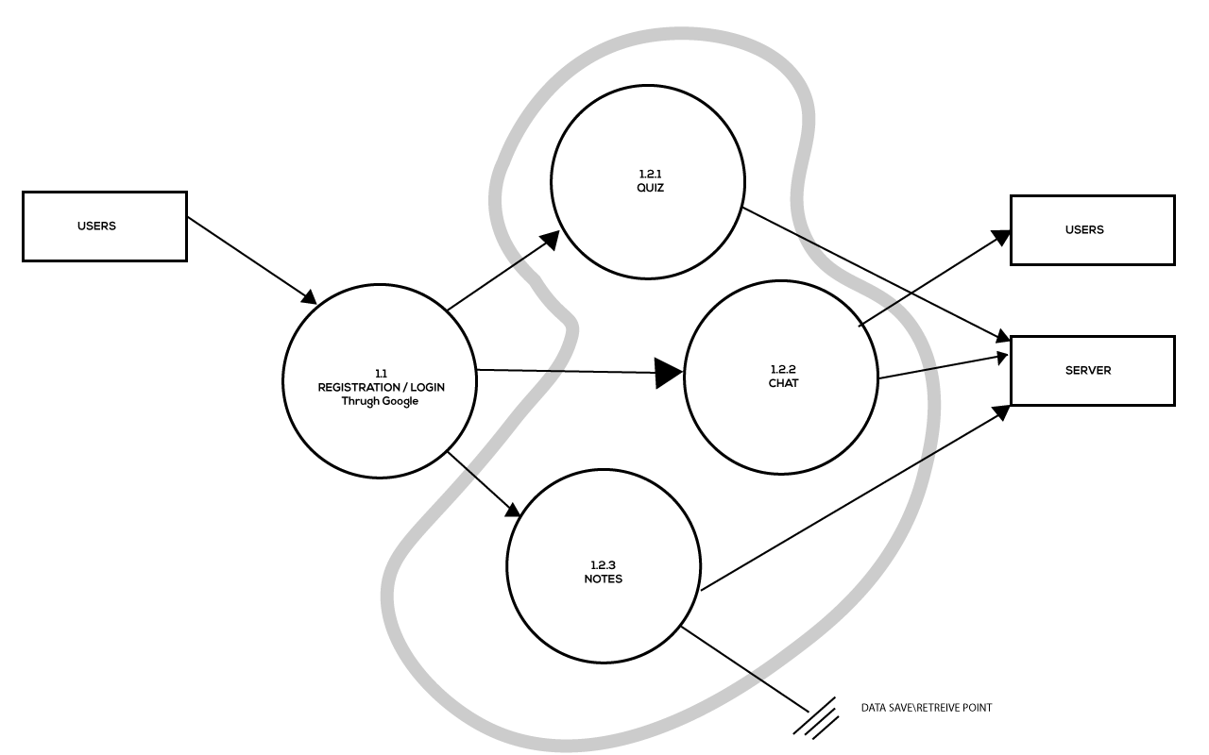
Level 1
Data is efficient when normalised

Slide 28
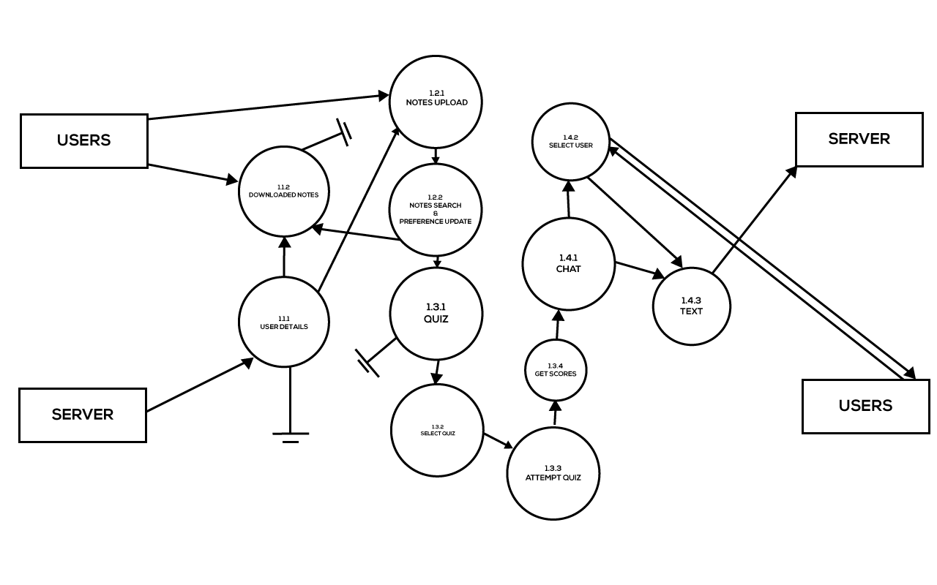
Level 2
Data is efficient when normalised

Slide 29
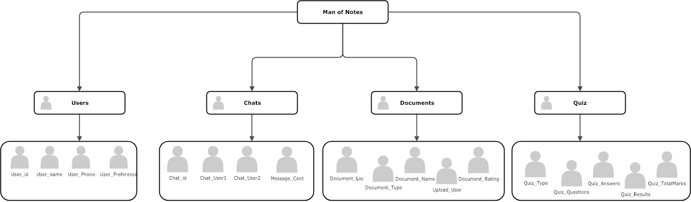
Realtime Database design
Data is efficient when normalised

Slide 30
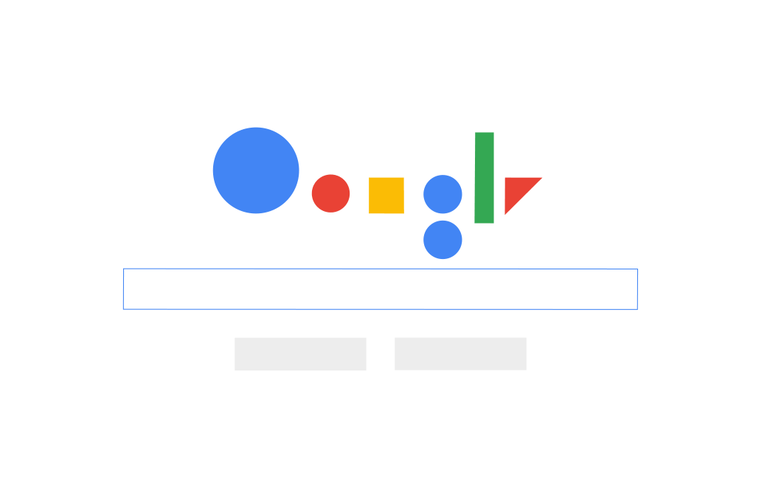
User-Interface

Slide 31

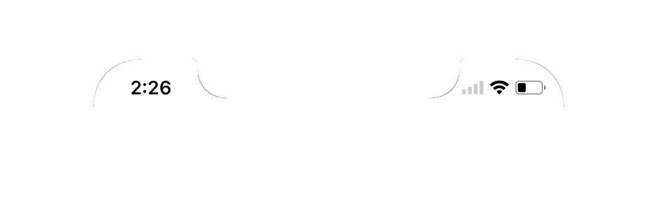
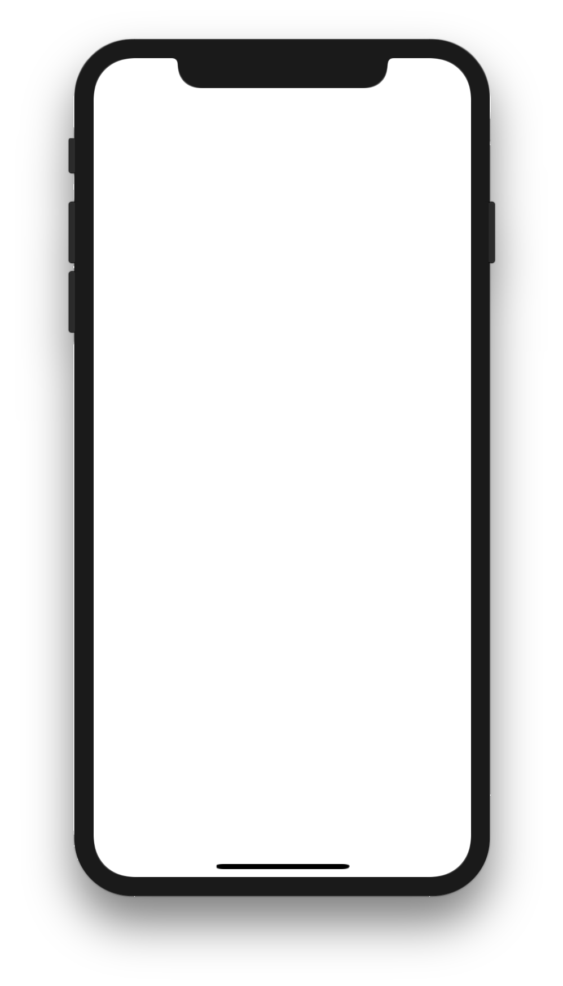

Splash Screen
UX matters!

Slide 32
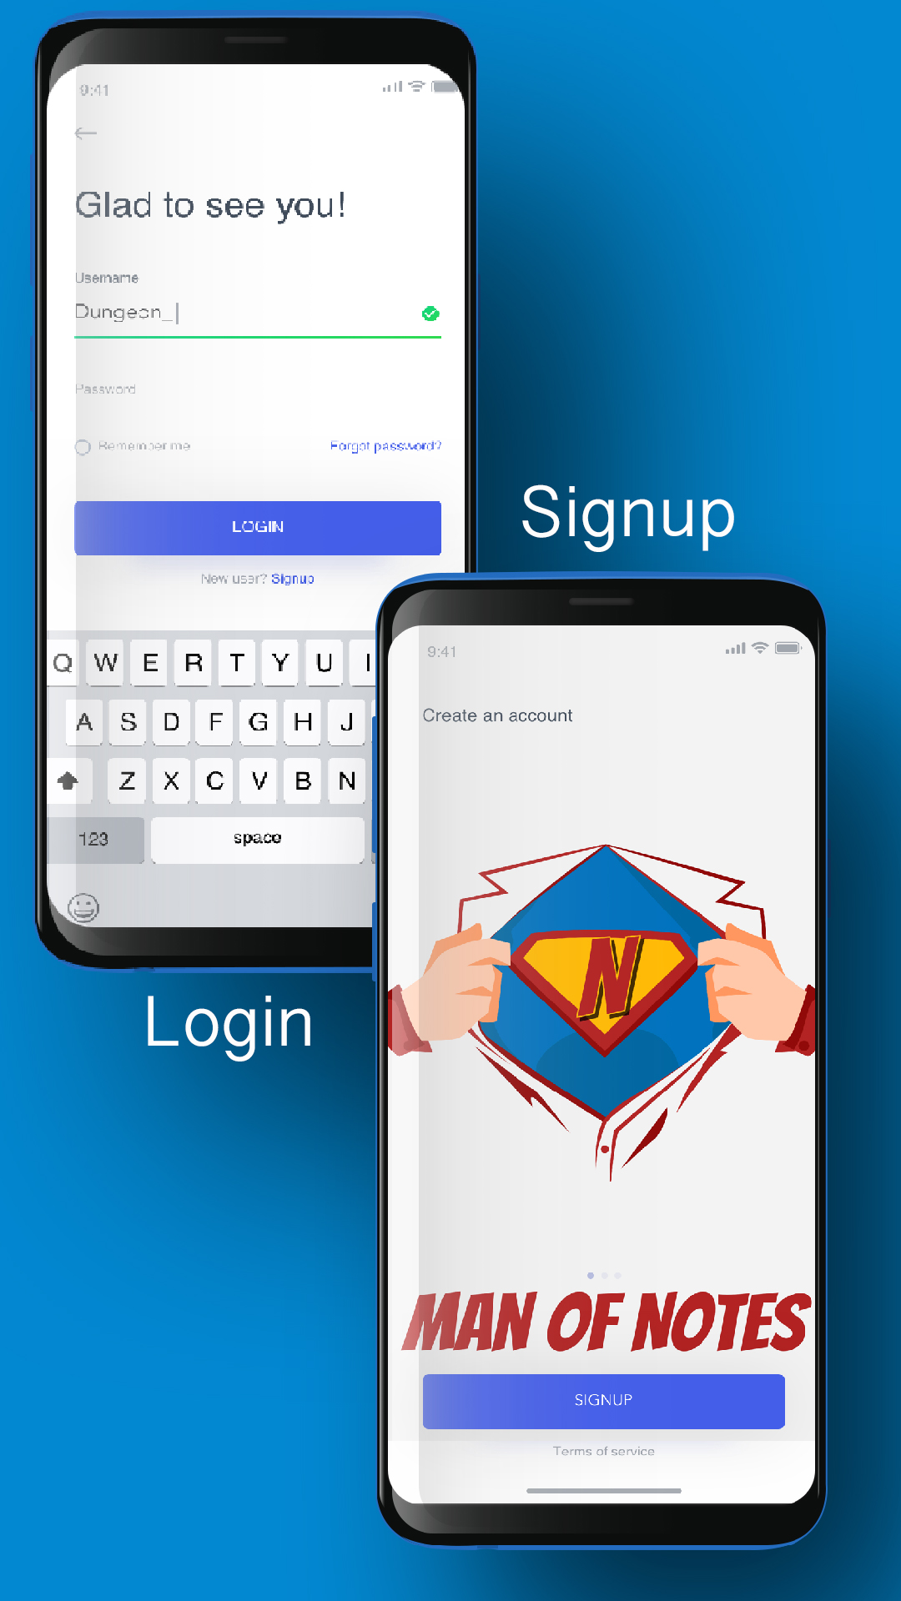
App Startup
UX matters!

Slide 33
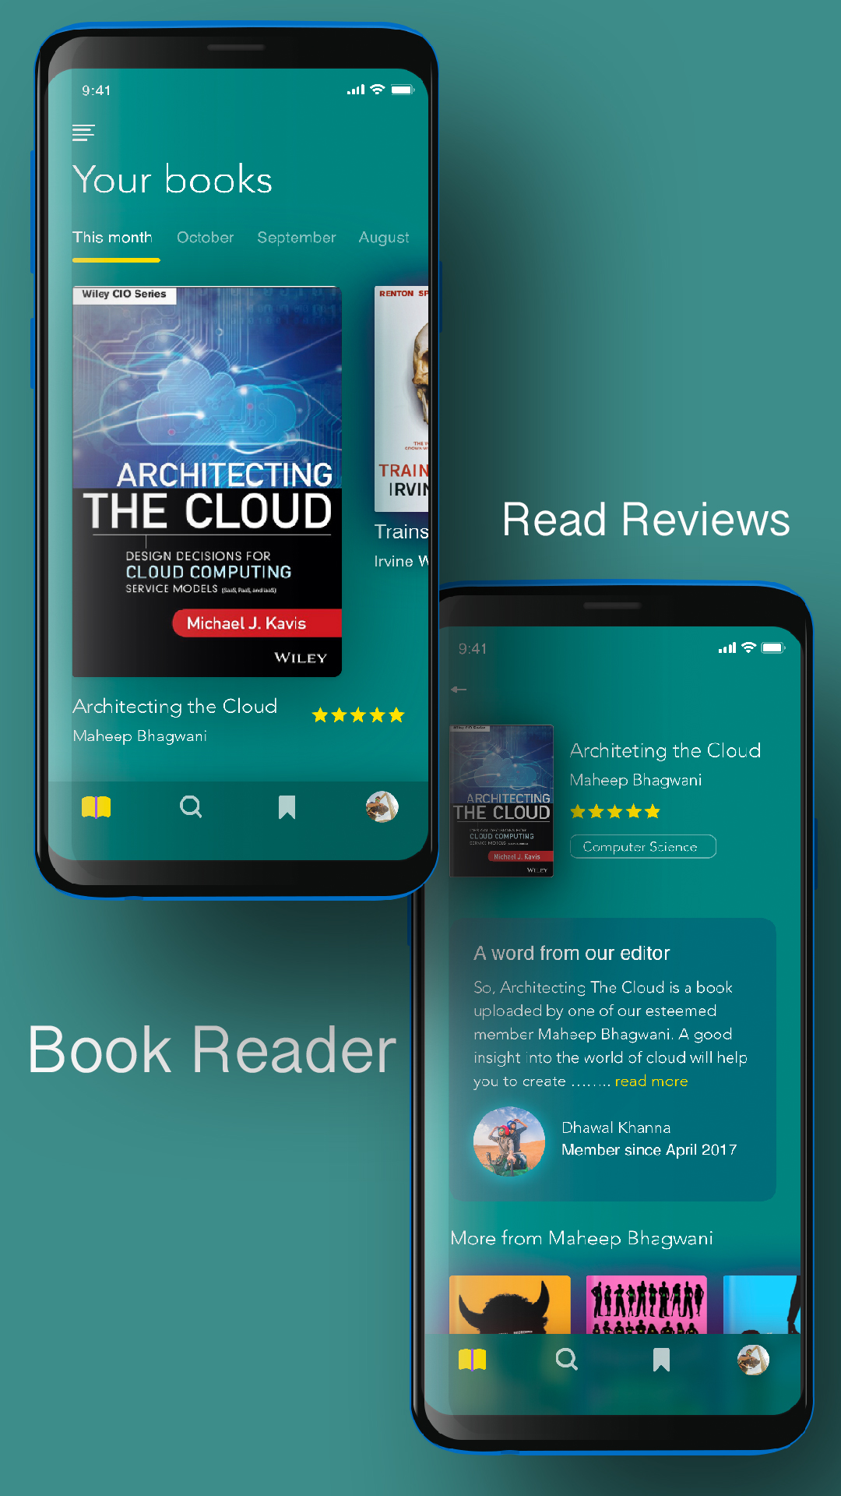

Notes Reader
UX matters!

Slide 34
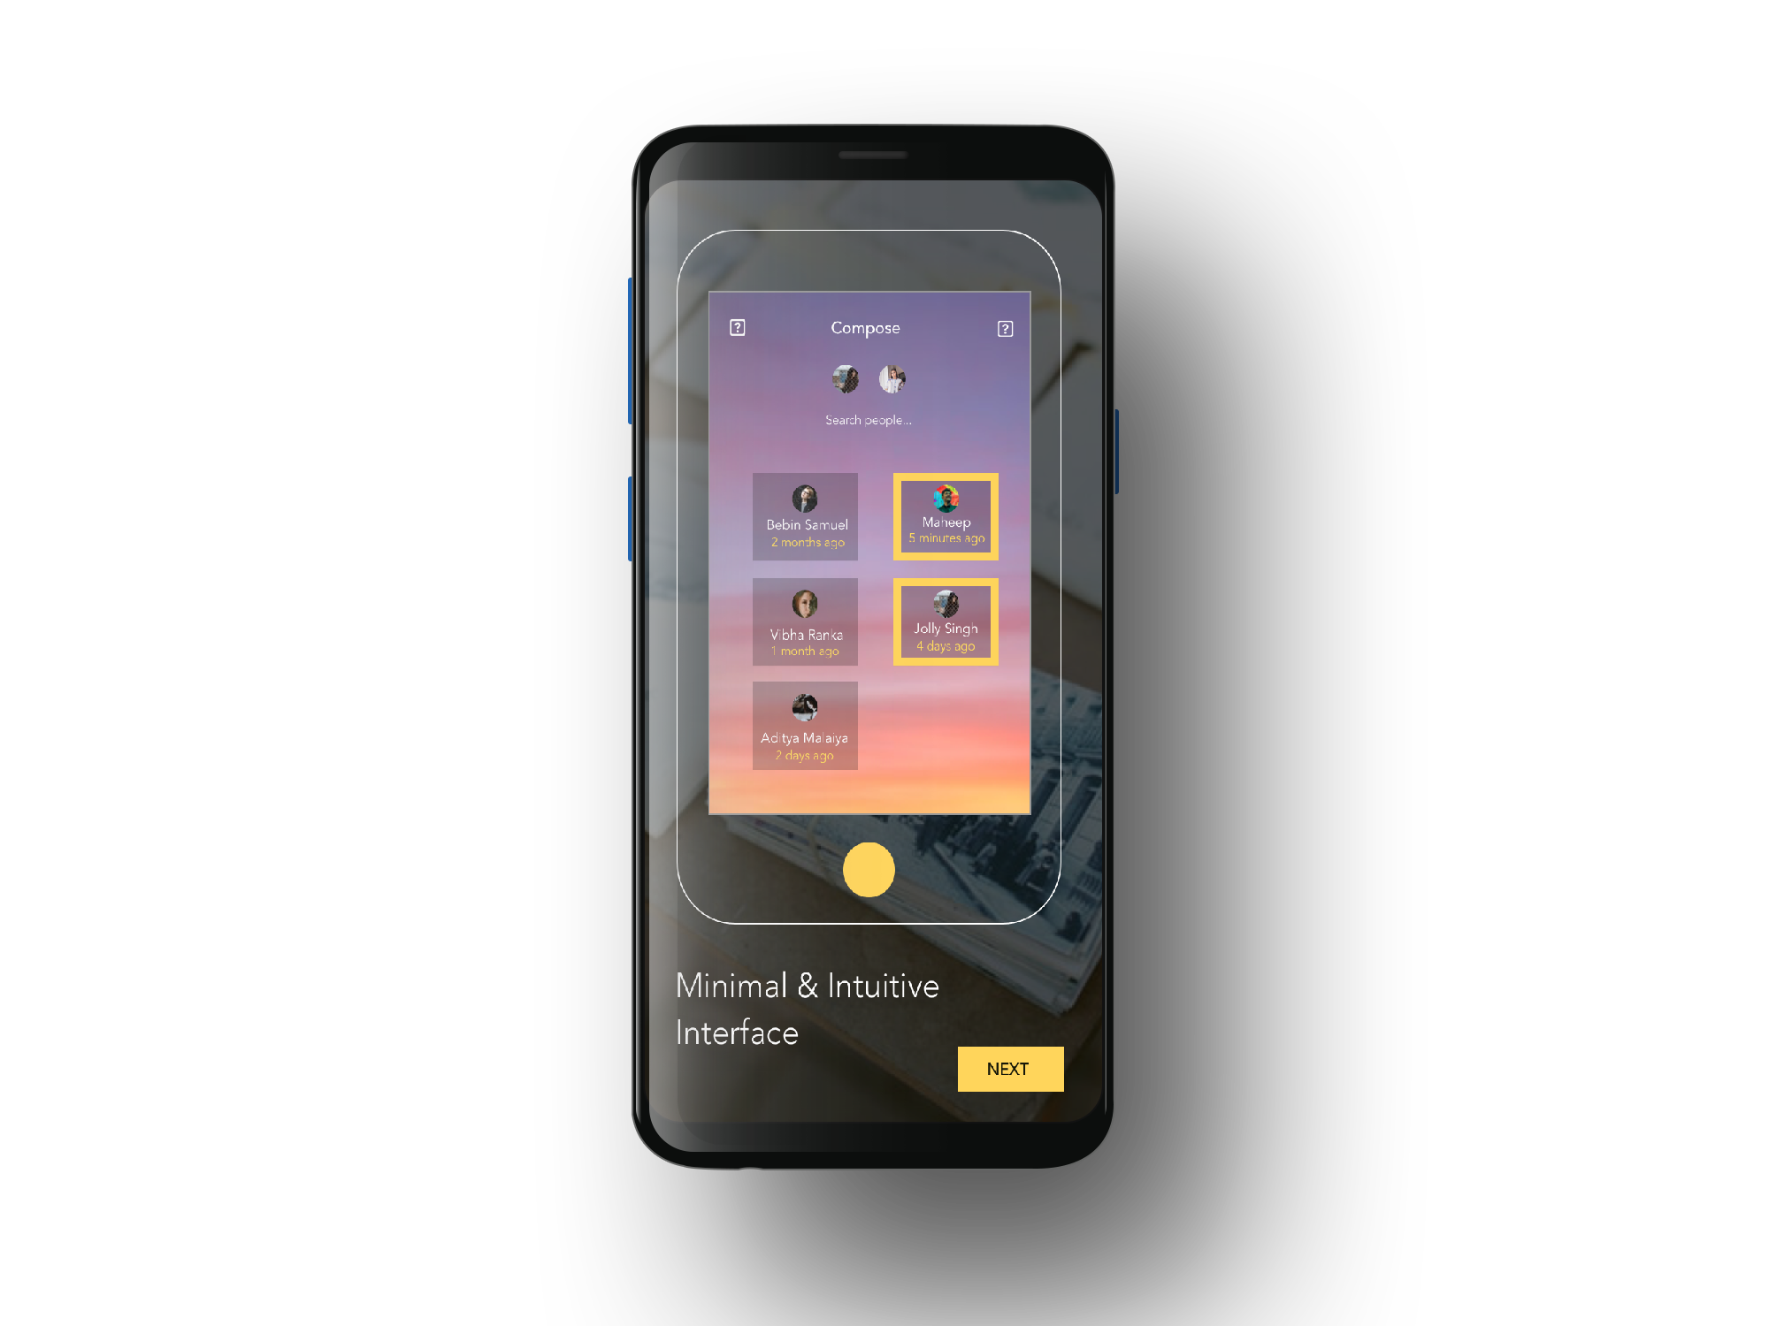
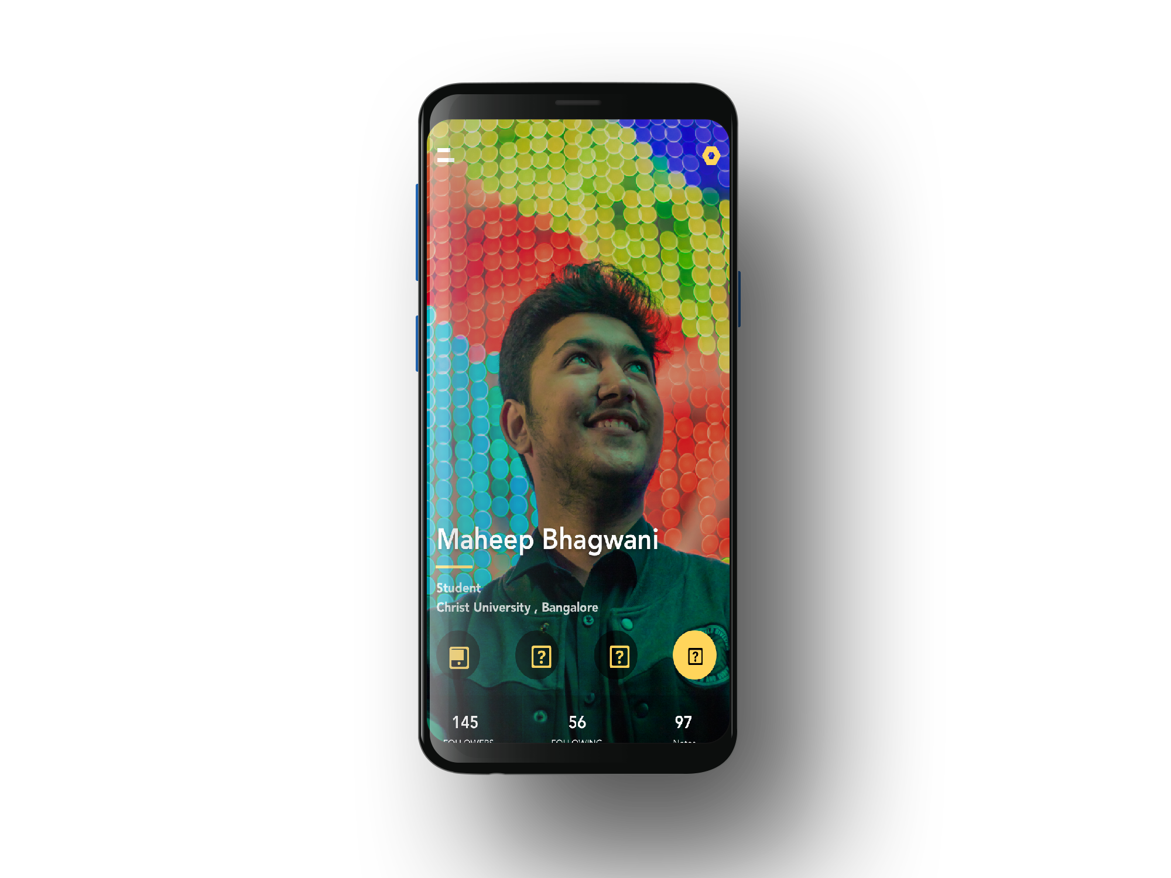
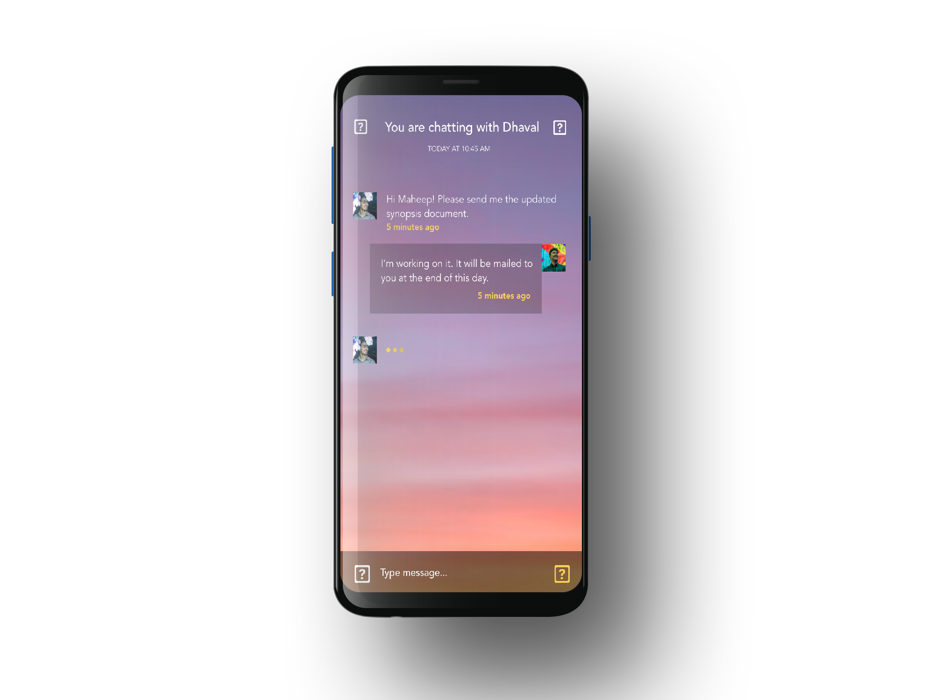
Chat UI
UX matters!

Slide 35
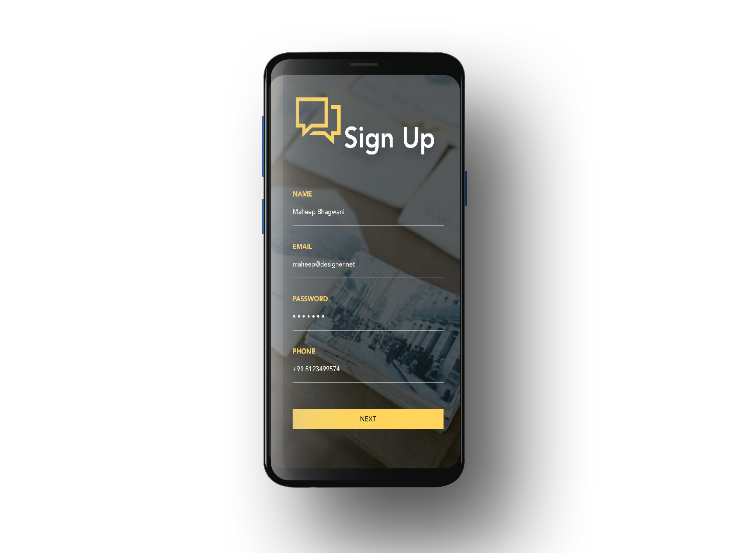
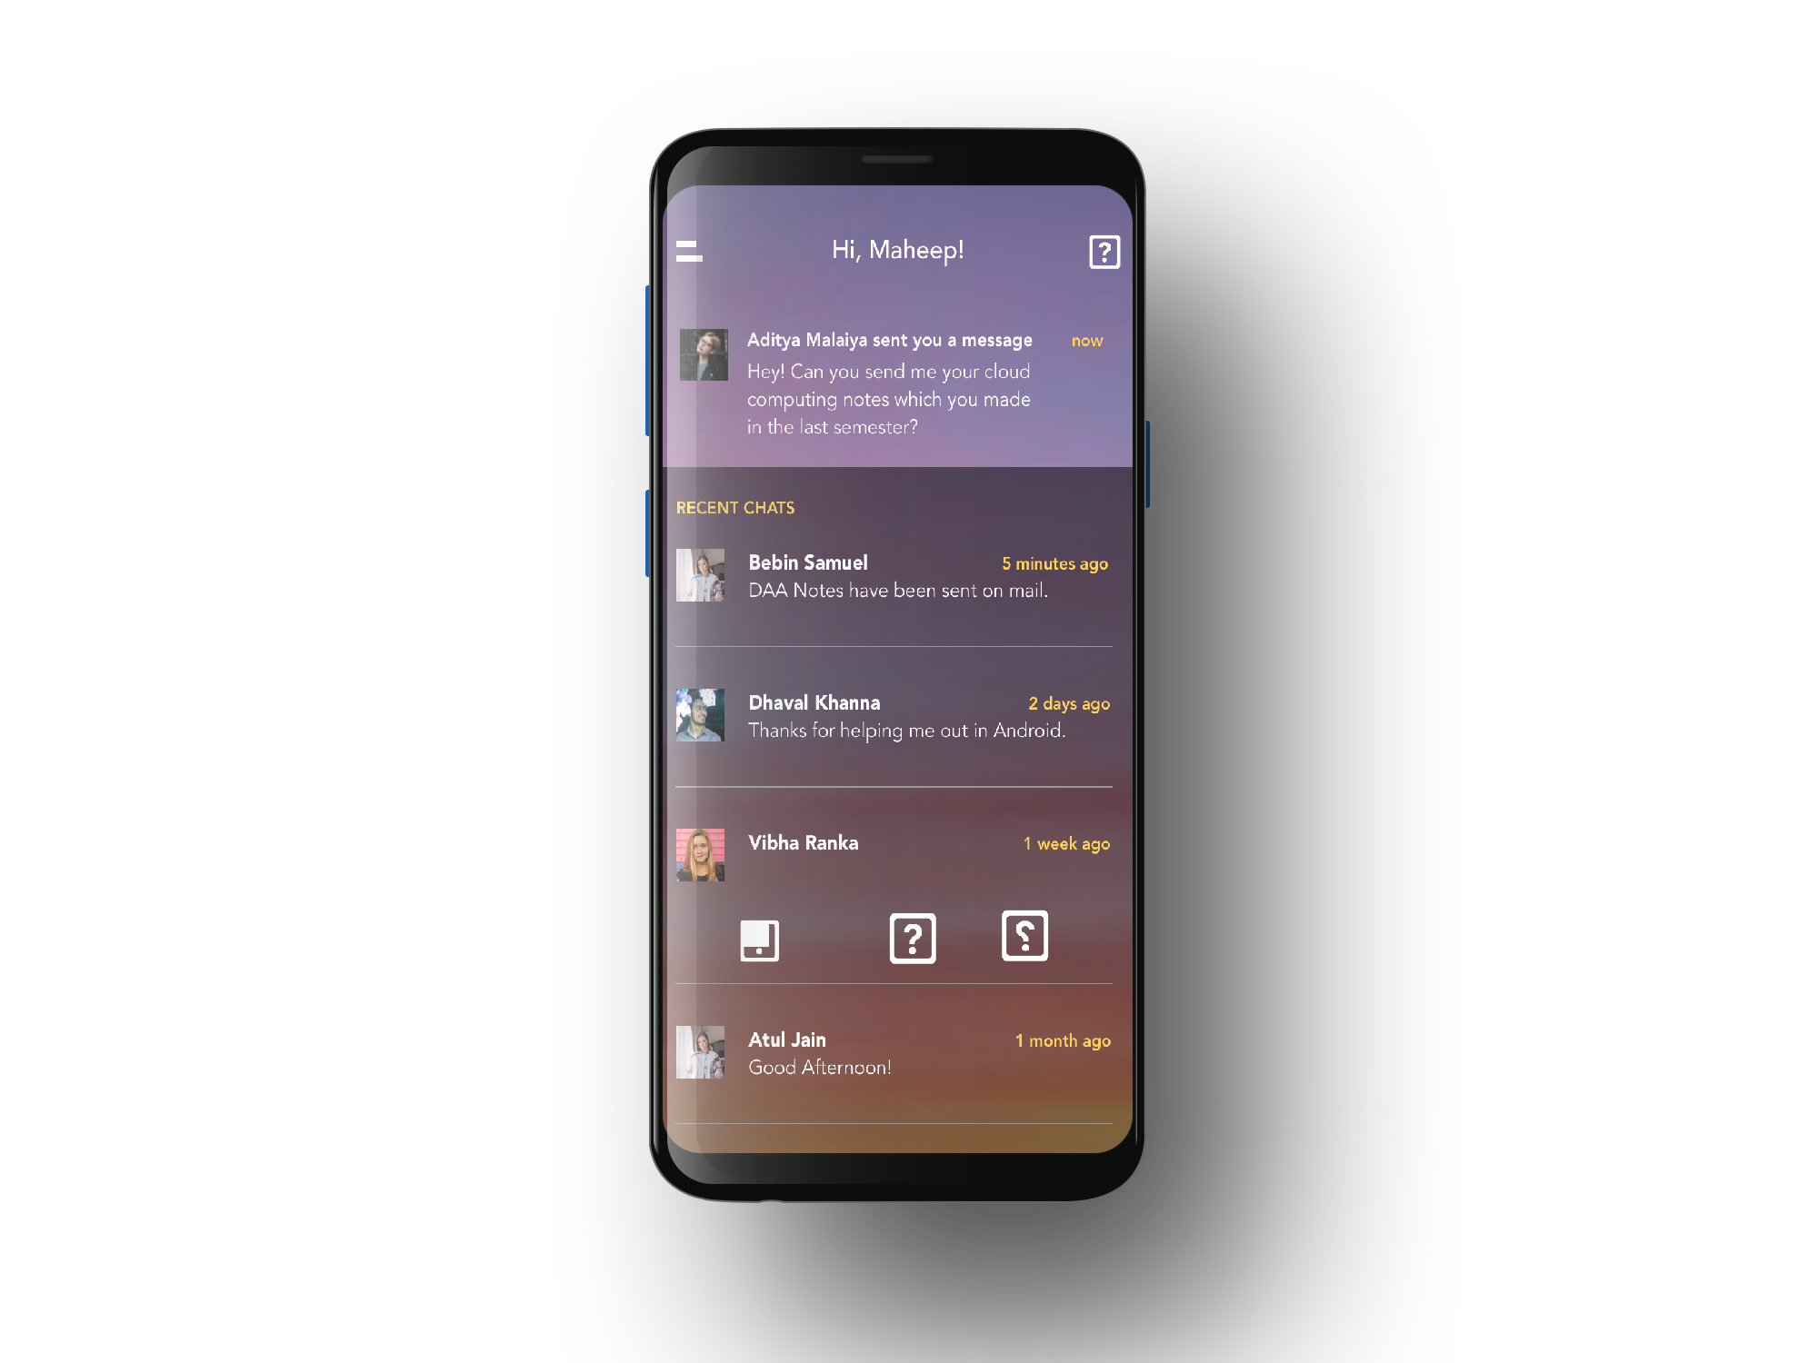

Chat UI
UX matters!

Slide 36



Slide 37


